Slide 1
Museum Art Curation
Group 23: Prashant Ravi, Fatima Vahora, Haeun Suh

Slide 2
Data Background
The Art Institute of Chicago located in Grant Park, Chicago opened its doors to the public in 1879 by presenting exhibits by Van Gogh , Seurat, Cezanne .
2 The museum features 98,361 artworks from 27,140 artists and 140,848 records approximately.
3. Museums such as Cooper Hewitt, Metropolitan Art Museum and the Carnegie Art Museum also archive art data.
4 . Art Institute of Chicago consists 22,000 folders of exhibition records dating from 1879 to 1989 from its registrar and curatorial departments.
5. However, The Data is not Curator approved!

Slide 3
Data Format (CSV to DataFrames)
It includes basic metadata for each artist including name, nationality, gender, birth year, death year, Wiki QID, and Getty ULAN ID.
Header:
title,creation_date,creation_date_earliest,creation_date_latest,medium,accession_number,id,credit_line,date_acquired,department,physical_location,item_width,item_height,item_depth,item_diameter,web_url,provenance_text,classification,image_url,artist_id,party_type,full_name,cited_name,role,nationality,birth_date,death_date,birth_place,death_place\n
1979.486.1,False,False,False,1,,The American Wing,1979,Coin,One-dollar Liberty Head Coin,,,,,,16429,Maker," ",James Barton Longacre,"American, Delaware County, Pennsylvania 1794–1869 Philadelphia, Pennsylvania"," ","Longacre, James Barton",American,1794 ,1869 ,,http://vocab.getty.edu/page/ulan/500011409,https://www.wikidata.org/wiki/Q3806459,1853,1853,1853,Gold,Dimensions unavailable,"Gift of Heinz L. Stoppelmann, 1979",,,,,,,,,,,,,,http://www.metmuseum.org/art/collection/search/1,,,"Metropolitan Museum of Art, New York, NY",,,
Average attributes count: 20 , Cumulative dataset size : 1GB.
Do stratified sampling of 0.01 using vizierdb tool.

Slide 4
Data Curation
Curation at Scale is a challenge with such a large scale and so many records
Incentivizing the Museums that to share their records publicly.
Data Quality and Validation of Data along with missing information.
Trust and Provenance of the data without quality data, these new machine learning tools do not add much value to the discourse and use of art.
Schema Matching and Query Containment on mediated schema

Slide 5
Database Instance
Source 1: moma-artist.csv
Source 2: met-artists.csv
Target Schema met-objects.csv

Slide 6
Data Cleaning
1. Multiple artists for a record, delimited by a separator and each artist should be accredited to the record. Exploded the entries by delimiter.
2. Some of the accession years are not dates so they should be ignored by setting to NaN.
3. Some artists are anonymous, unknown or identified by the location rather than an actual name so they should befittingly named "anonymous".
4. Certain Begin Dates are after the End date. Certain dates don't specify B.C or A.D and others are 0. Fill such entries with NaN
5. The nationality column had upper case and lower case so standardizing the Artist Name and Nationality columns.
6. Handling missing information by merging information from other data sources on certain columns. Using unsupervised learning techniques such as Hierarchical Clustering techniques.
7. ULAN id needed to parsed from URL to check for equivalence.
8. Extract the dates from format "MM-DD-YYYY" to YYYY for all datasets.

Slide 7
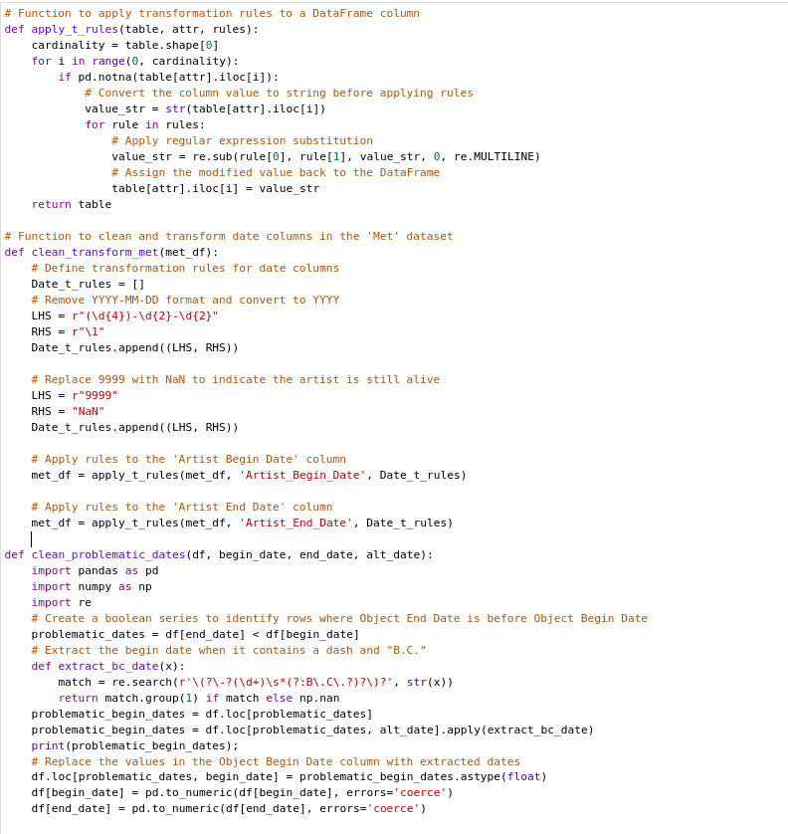
Data Cleaning
Example of cleaning procedure:
1.extract the dates from certain columns
2.nullify dates where the start date appear after end date.

Slide 8
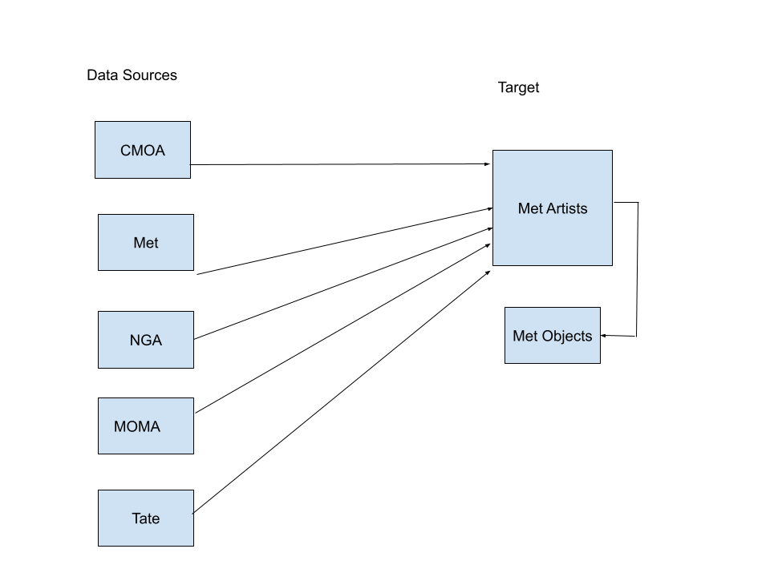
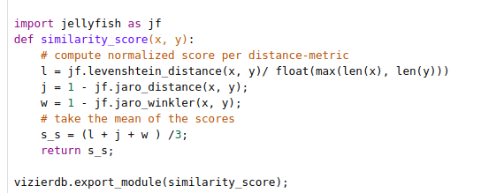
Schema Matching
1. Calculate the Jaro, Jaro Winkler Similarity and the Levenshtein Distance and take the average of these three between pairwise attribute names to identify which attributes are closest match pairwise.

Slide 9
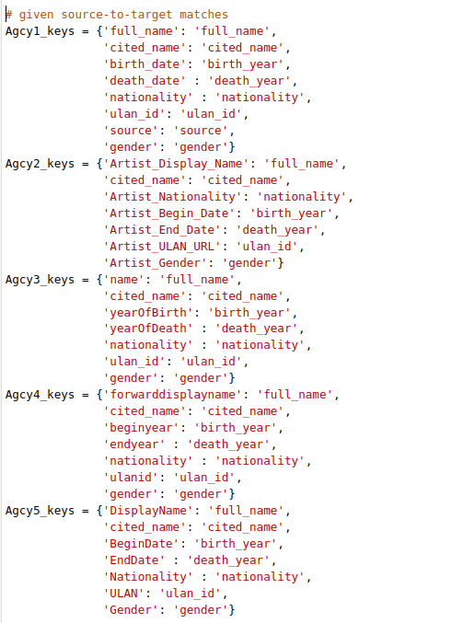
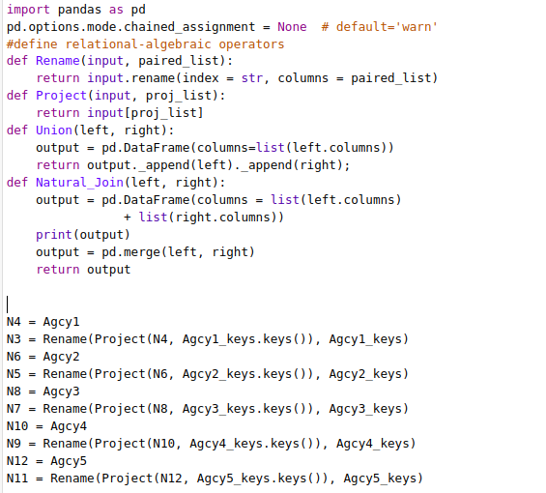
Schema Matches found via similarity score

Slide 10
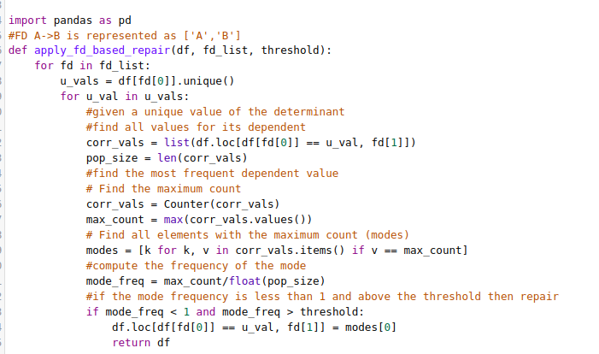
Apply functional based dependency repair
We have identified the following functional dependency
full_name -> nationality
full_name -> birth_date
full_name -> death_date
FD Conflicts are resolved
by popular vote.

Slide 11
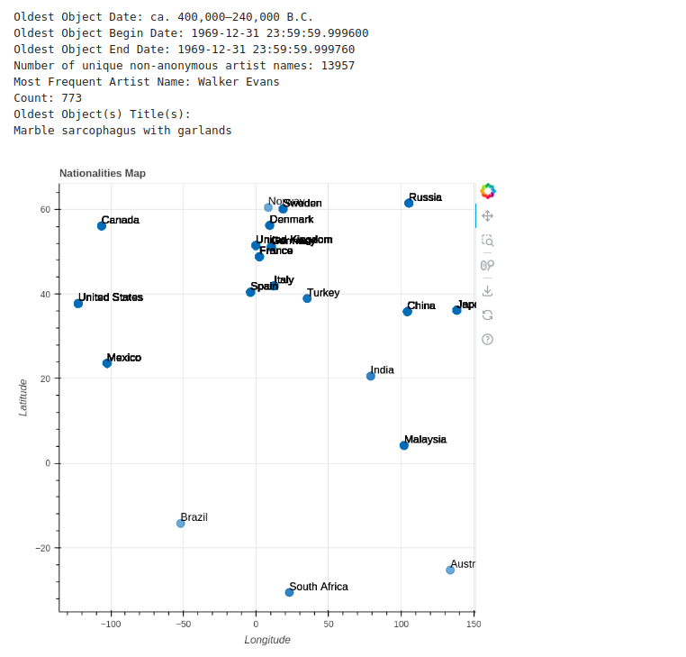
Exploratory data analysis

Slide 12
Entity Resolution
We have so far a large dataset with data frames from various sources that have been integrated to one mediated schema, however, we must deduplicate records.
We evaluate three possible approaches for entity resolution:
1. Sorted Neighborhood
2. Logistic Regression classifier

Slide 13
Sorted Neighborhood

Slide 14
Candidate pair scoring
The similarity scores for candidates pairs are calculated by various attributes.
1. Exact matching on full_name
2. Exact matching on ULAN id
3. Fuzzy Matching on artist names - cosine similarity of names
4. Exact matching on nationality

Slide 15
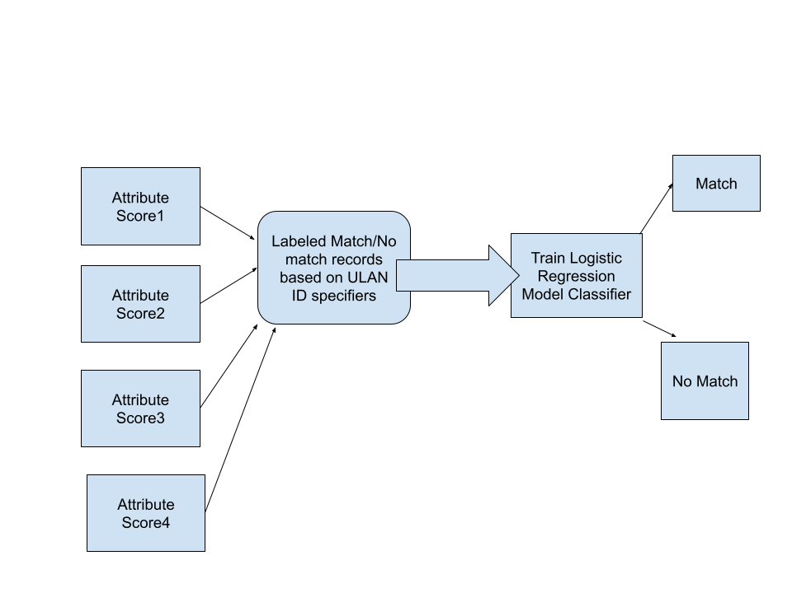
Logistic Regression classifier

Slide 16
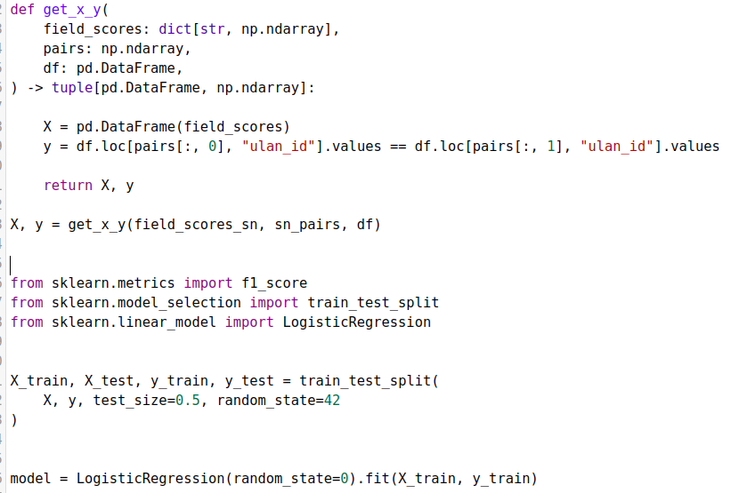
Classifier Performance
F1-score:
0.86

Slide 17
Center Clustering

Slide 18
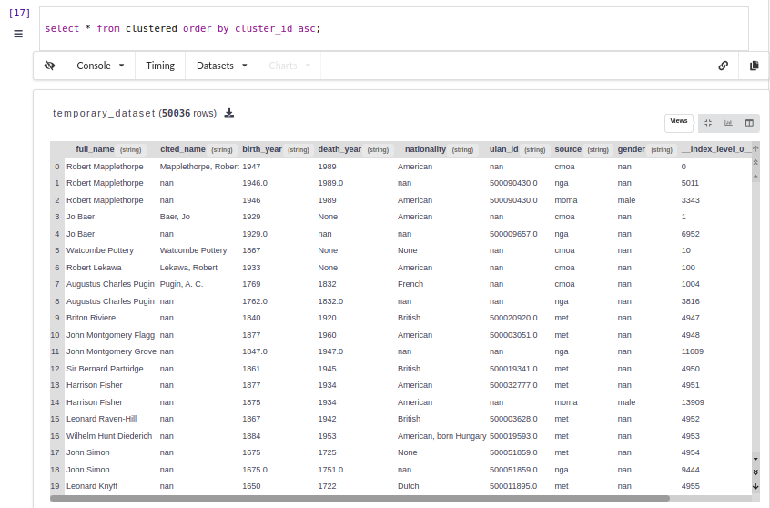
Data Integration

Slide 19
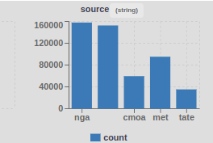
Data Fusion
1. Cluster id for each record and records in a cluster map to same entity.
2. Aggregate values such as gender, nationality, birth_year, death_year and also provide a column for the most popular source provider of this record to create a single record for each artist.
3. . Probabilistic record linkage between Met Artists and Met Objects based on full_name.
The Fellegi-Sunter model compares selected similar fields in two records and calculates a similarity score, or a weighted probability of the two records being the same entity.

Slide 20
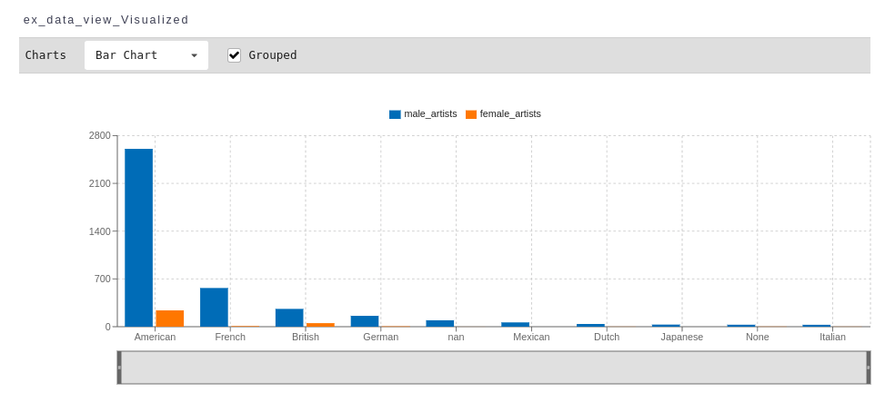
Exploratory Data Analysis on aggregated data
1. Plot the art accessions from various nationalities across the years by gender and other visualizations from a common collective data source.
many nationalities are nan

Slide 21
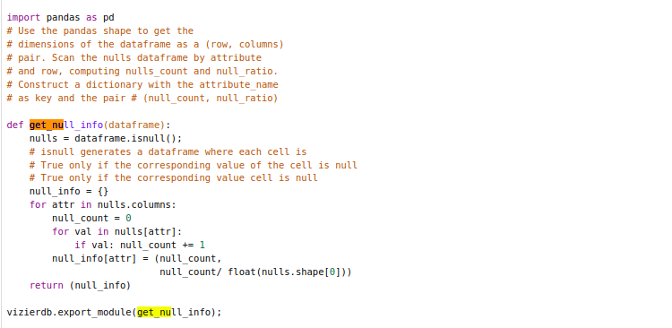
Impute Missing Values
Used multilayer perceptron to impute missing nationality values for nationality and evaluate null information on columns.
{'Object_Number': (0, 0.0), 'Object_ID': (0, 0.0), 'Department': (0, 0.0), 'AccessionYear': (168, 0.004882443546746491), 'Object_Name': (110, 0.0031968380365602024), 'Title': (533, 0.015490133395332617), 'Culture': (29364, 0.8533813827777617), 'Period': (33502, 0.9736406172803627), 'Object_Date': (1373, 0.03990235112906507), 'Object_Begin_Date': (0, 0.0), 'Object_End_Date': (0, 0.0), 'Artist_Display_Name': (0, 0.0), 'FirstName': (0, 0.0), 'LastName': (0, 0.0), 'first': (0, 0.0), 'last': (0, 0.0), 'full_name': (0, 0.0), 'nationality': (0, 0.0), 'birth_year': (530, 0.01540294690342643), 'death_year': (1861, 0.054084687145804874), 'gender': (0, 0.0)}

Slide 22
Data Curation Overview
1. Schema Matching: create a common schema that matches across the various sources to answer queries across the various data sets.
Q(Name, birth year, death year, nationality)
2. Aggregate the data such that a single artist id is generated for all the unique artists by matching ULAN identifiers and matching first name last name by using fuzzy matcher.
3. Archives may have been duplicated and the information about certain artists and their nationality, ethnicity could be differing, so majority voting aggregation of such records after identifying copies by using edit distance , Jaccard distance.

Slide 23
Future Work
Identify denial constraints, FDs,regression models that can predict for some anonymous art work who could have been the artist!
Using unsupervised learning algorithms such Latent Dirichlet Allocation to automatically fill missing value, K - means clustering algorithm and re-run analysis experiments.
Imputation of missing values was done by multilayer perceptron which is non-interpretable . So counterfactuals and rules could be identified which could explain why a nationality was selected by the black-box classifier.

Slide 24
Citations
https://github.com/IITTeaching/cs520-f23-group-23/blob/main/main-520-project/data%20curation%20project.txt
We base our work on the data released by these museums. These were chosen because they endorse the CC0 license, allowing a free and unrestricted use of the data.
Open source software such as Scikit-learn, Jellyfish, Pandas and Vizier DB.

